Slide 1

UI and UX Design
Principles of Material User Interface Design and User Experience based designs in practice

Slide 2
Outlines
Principles of Material UI
Material UI Guidelines
Colour Theory
UX-based Design
UX-based Design Examples

Slide 3
Sample 2
Principles of Material UI
Material: design should be inspired by the physical world. Like, using realistic motion and tactile surfaces.
Meaningfulness: each visual element should be associated with the context to facilitate user in a glance.
Motion: motion should be an essential part of design. Transitions between states should be smooth and aligned with spatial aspects.
User action focused: design should follow user’s actions. For example, most frequently used actions should be readily available.
Consistency/Responsiveness: user should get a consistent experience across different devices and screen sizes.
Accessibility: design should emphasize accessibility, ensuring that users with diverse abilities can also use the application.

Slide 4
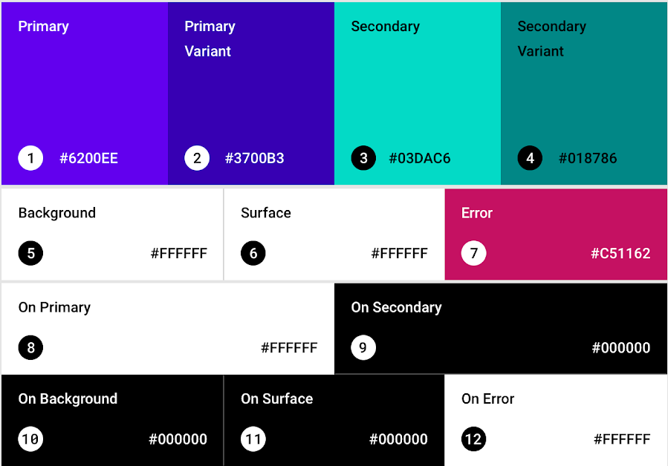
Sample 2
Material UI Guidelines – Colours
Implement a Colour theme.
Pick Primary, Secondary and Background colours before choosing variants.
Notes:
Guidelines from: https://m2.material.io

Slide 5
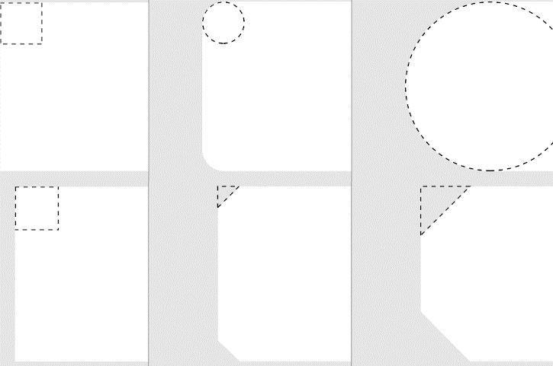
Sample 2
Material UI Guidelines – Shapes
Pick one shape. Solid, Rounded or Cut.
Be consistent with your design decision.
When using Dark and Light theme combination, see the design on both.
Notes:
Guidelines from: https://m2.material.io

Slide 6
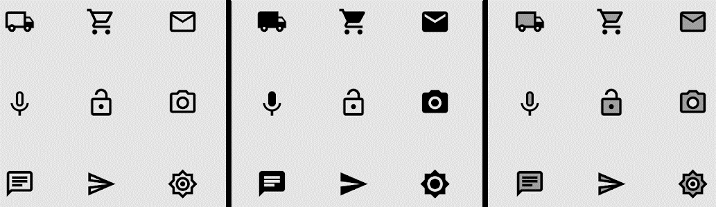
Sample 2
Material UI Guidelines – Icons
Icons should first be meaningful, then aesthetic.
Icons can be outlined, filled and two-toned. Depending on use case.
When an icon is disabled, reduce its transparency or blur it.
Notes:
Guidelines from: https://m2.material.io

Slide 7
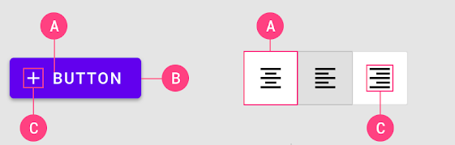
Sample 2
Material UI Guidelines – Buttons
Buttons are very frequently used controls. A button should have:
Short, self-explanatory text
Container with centered contents and equal padding
Optional icon for accessibility
Ideally, a Button should have different colour/tone for each state: Out of focus, on hover, pressed, disabled, toggled.
Notes:
Guidelines from: https://m2.material.io

Slide 8
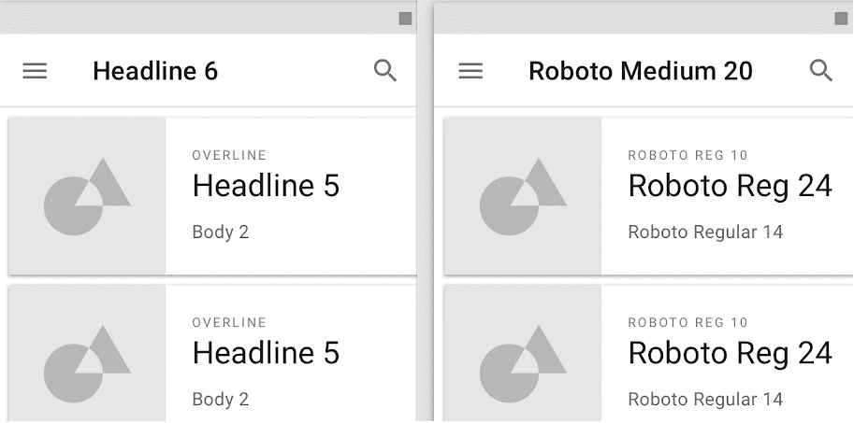
Sample 2
Material UI Guidelines - Typography
Prefer defining text scale with categories (e.g., H1, H3) numbers. If using an uncommon font, put it in assets to load on app launch.
Notes:
Guidelines from: https://m2.material.io

Slide 9
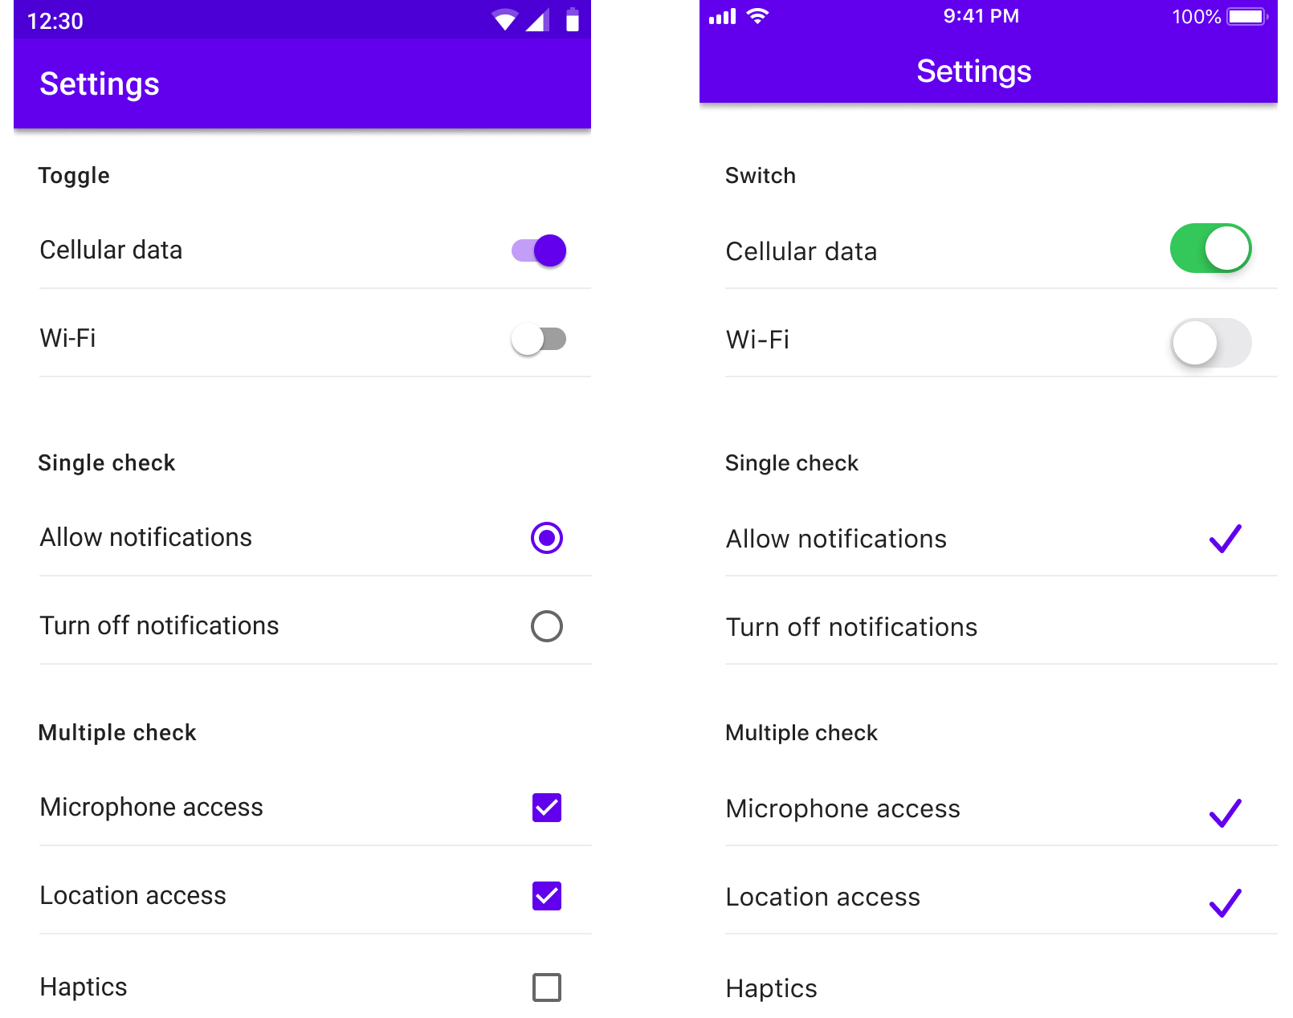
Sample 2
Material UI Guidelines – Cross-compatibility
Cross-platform compatibility. Assess the two screens given.
On left is Android OS and on right is iOS.
The designer ensured that the user gets the same experience on either of the platforms.
Notes:
Guidelines from: https://m2.material.io

Slide 10
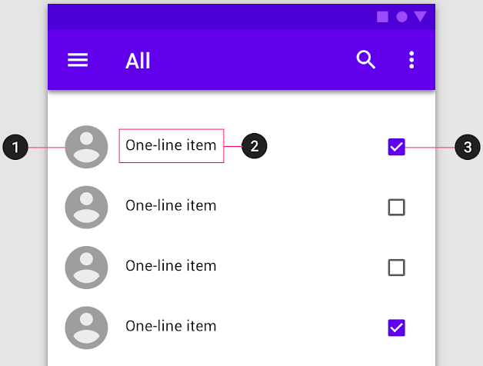
Sample 2
Material UI Guidelines – Lists
Lists should be orderly and actionable
Supporting visual
Primary text
Action control
Notes:
Guidelines from: https://m2.material.io

Slide 11
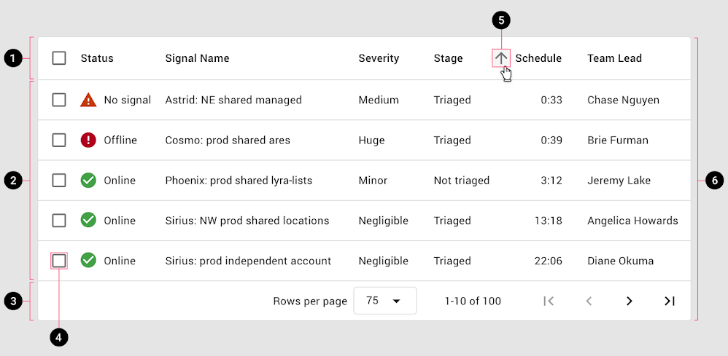
Sample 2
Material UI Guidelines – Data tables
Header
Rows
Pagination
Row checkbox
Sort options
Table Container
Notes:
Guidelines from: https://m2.material.io

Slide 12

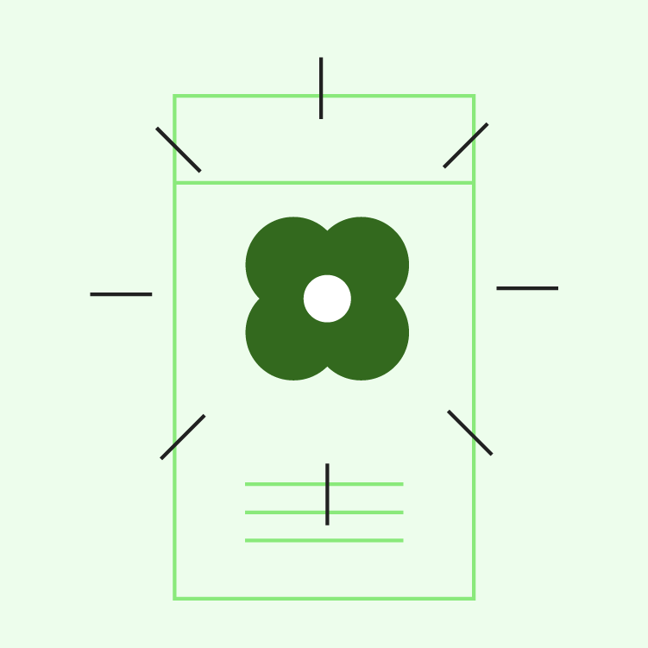

Sample 2
Material UI Guidelines – Imagery
A picture is worth thousand words.
Informative: convey the message
Delightful: look pleasing
Intentional: connect with the story
Notes:
Guidelines from: https://m2.material.io

Slide 13
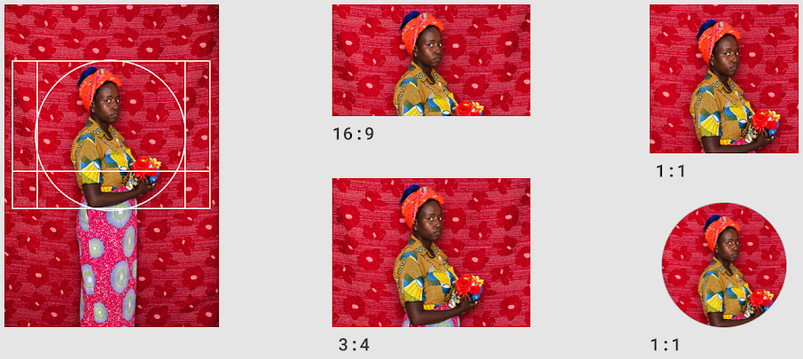
Sample 2
Material UI Guidelines – Imagery
Each image should have a focal point, which should not get lost on changing aspect ratio.
Notes:
Guidelines from: https://m2.material.io

Slide 14

Sample 2
Material UI Guidelines – Imagery
Keep different sizes for different resolutions and use responsive controls to load the right one.
Notes:
More on: Imagery - Material Design

Slide 15
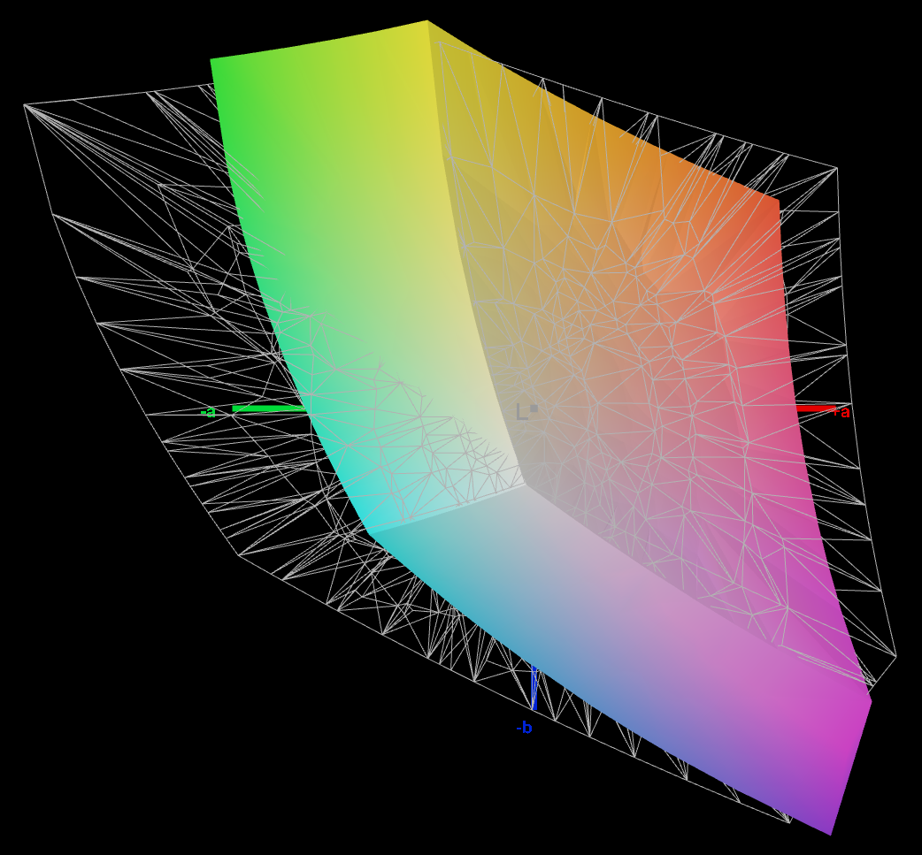
Sample 2
Material UI Guidelines – Target Display
Consider your primary user. Is it going to be on phone, tablet, desktop computer, TV, or a Watch?
From layout, to sizing, to colour selection, all decisions should be focused on primary user.
Featured devices do not have high accuracy. Purple may blend into Violet. Sea green and Teal colours are lookalikes.
Test for sRGB or Adobe RGB coverage.

